Slide 1



Engineering Ethics (HSS-422) (3+0)
ENGR. SYED RIZWAN ALI
Assistant Professor,
Head of Business Incubation Center,
Bahria University (Karachi Campus)

Slide 2
Case study - Transforming Ethical Decision-Making in Organizations
Engineering Ethics (HSS-422) (3+0)
Week No 07
By Engr. Syed Rizwan Ali
Notes:
More Discussion about of the Lecture

Slide 3
Learning Outcomes
In this Lecture will cover ..
Significant Improvement in Organizational Culture and Ethical Decision-Making Processes.
Increased Employee Perception of the Company’s Ethical Climate.
Improved Trust and Collaboration with Stakeholders.
Decrease in Reported Incidents of Unethical Behavior.
Key Lessons on Leadership and Cultural Change.

Slide 4
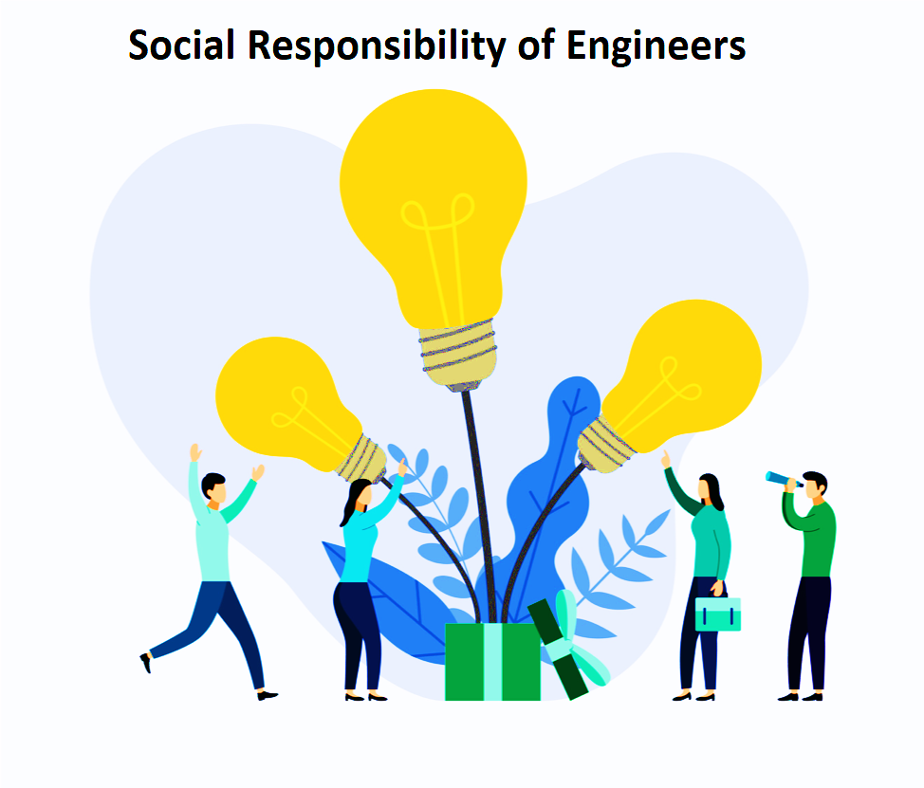
CASE STUDY

Slide 5

A Case Study of XYZ Corp’s Multifaceted Approach

Slide 6
Transforming Ethical Decision-Making in Organizations
A Case Study of XYZ Corp's Multifaceted Approach
Abstract: Exploring barriers to ethical decision-making: self-interest, self-deception, fear, ignorance, egocentric tendencies, microscopic vision, uncritical acceptance of authority, and groupthink. Recommendations for fostering ethical awareness.

Slide 7
Transforming Ethical Decision-Making in Organizations
A Case Study of XYZ Corp's Multifaceted Approach
Abstract: Exploring barriers to ethical decision-making: self-interest, self-deception, fear, ignorance, egocentric tendencies, microscopic vision, uncritical acceptance of authority, and groupthink. Recommendations for fostering ethical awareness.

Slide 8
Transforming Ethical Decision-Making in Organizations
Introduction: The significance of overcoming psychological, social, and systemic barriers to ethical decision-making in organizations.
Case Description: XYZ Corp's expansion challenges in the renewable energy sector and the impact of identified impediments on ethical decision-making.
Method: Mixed-methods approach combining qualitative interviews and quantitative surveys to explore the interplay between personal motivations and systemic pressures.

Slide 9
Transforming Ethical Decision-Making in Organizations
Finding: Key issues include a gap between stated values and behaviors, influence of leadership, and a culture stifling ethical considerations.
Solutions and Implementation Plan: Leadership training, ethical decision-making frameworks, whistleblower policies, culture change initiatives, and their implementation.
Results: Improved organizational culture and ethical decision-making processes, increased employee perception of ethical climate, decreased unethical behavior.

Slide 10
Transforming Ethical Decision-Making in Organizations
Lessons Learned and Future Directions: Importance of leadership, ethical frameworks, cultural change, and exploring long-term impacts and applicability across industries.
Conclusion: XYZ Corp's journey illustrates overcoming impediments to ethical decision-making through a comprehensive strategy, highlighting the effectiveness of a holistic approach.

Slide 11
Transforming Ethical Decision-Making in Organizations
Questions:
1. What were the primary impediments to responsible action identified in XYZ Corp's case study?
2. How did XYZ Corp approach the challenge of fostering ethical decision-making within its organization?
3. What methodology was employed in the case study to analyze the impediments to ethical decision-making at XYZ Corp?
4. What were the main outcomes of implementing the multifaceted solution at XYZ Corp?
5. What were the key lessons learned from XYZ Corp's implementation of its ethical decision-making strategy?

Slide 12

Case Study 02

Slide 13
Case Study 02: Software Engineering
Title: Impediments to Responsible Action in Software Engineering Ethics
“An ethical dilemma in software security” management.
Introduction: Software engineers must adhere to ethical principles. However, various impediments hinder responsible action, leading to ethical failures.

Slide 14
Case Study 02: Software Engineering
Case Scenario: The Compromised Security Patch
A cybersecurity company, TechSecure, identifies a critical security flaw in a banking system. However, the management pressures the team to delay the fix to protect business interests.

Slide 15
Case Study 02: Software Engineering
Impediments to Responsible Action
Self-Interest: Profit motives delaying security patches.
Self-Deception: Downplaying the severity of risks.
Fear: Employees afraid of job loss if they speak up.
Ignorance: Junior developers unaware of ethical concerns.
Egocentric Tendencies: A senior engineer refusing to acknowledge design flaws.

Slide 16
Case Study 02: Software Engineering
Impediments to Responsible Action
Microscopic Vision: Short-term impact prioritized over long-term safety.
Uncritical Acceptance of Authority: Engineers following unethical directives.
Groupthink: Collective agreement despite ethical concerns.

Slide 17
Case Study 02: Software Engineering
Outcome and Consequences
Security patch was delayed for three weeks.
A hacker exploited the flaw, leading to major financial losses.
The company faced lawsuits and reputational damage.
Employees who remained silent became complicit in the failure.

Slide 18
Case Study 02: Software Engineering
Lessons Learned
Ethical Courage: Employees should feel safe raising concerns.
Avoiding Self-Deception: Acknowledge risks honestly.
Challenging Authority: Question unethical management decisions.
Preventing Groupthink: Encourage diverse perspectives.
Long-Term Ethics: Protecting users should outweigh short-term gains.

Slide 19
Case Study 02: Software Engineering
Conclusion
Overcoming impediments to ethical decision-making in software engineering requires strong ethical leadership, open communication, and prioritizing responsibility over profit.

Slide 20
Thanks Any Question ?????

